Slide 1

Website Style Guide

Slide 2
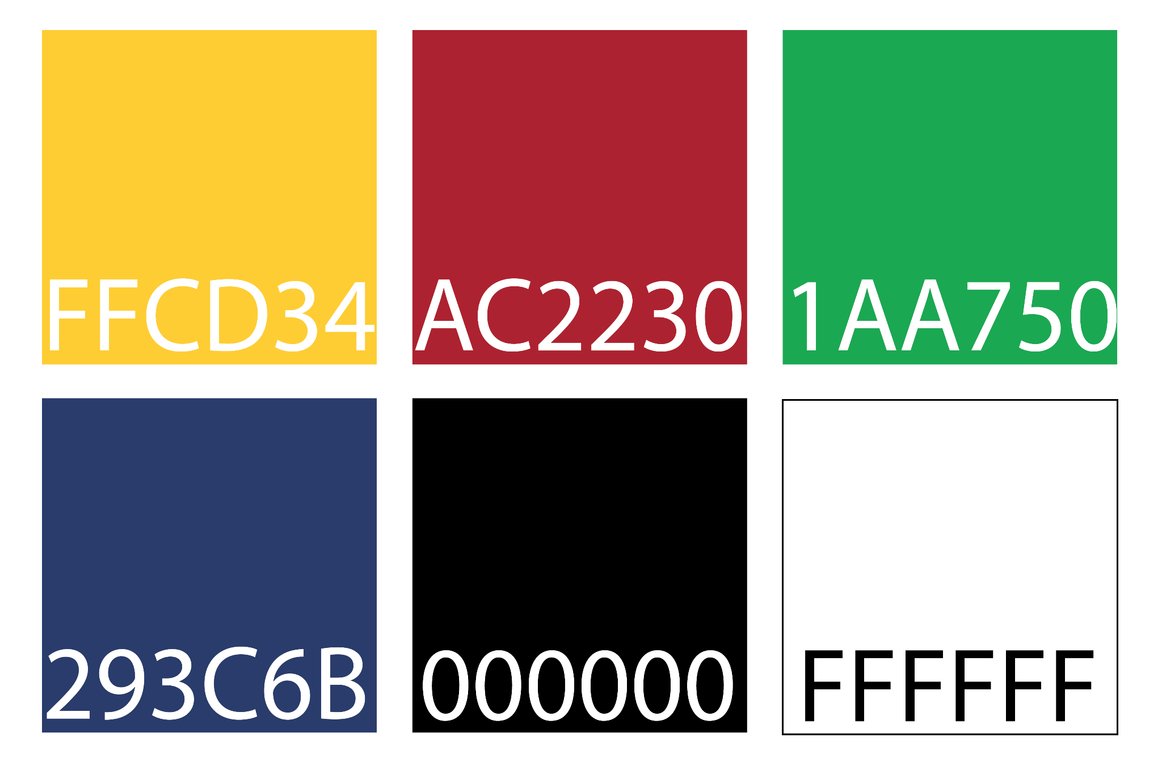
Hex color codes

Slide 3
Fonts
Header font (Nunito)
Header font (Nunito)
OR
Header font (Lato)
Header font (Lato)
Text font (Calibri)
Website tabs (Calibri)

Slide 4
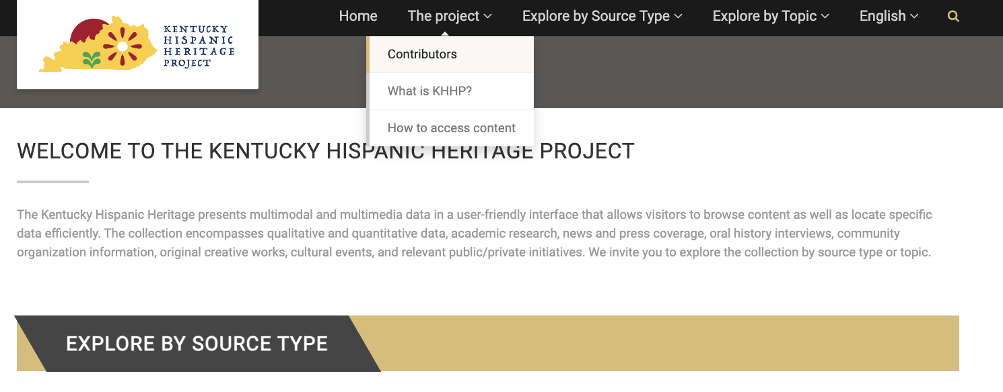
General style notes

Slide 5
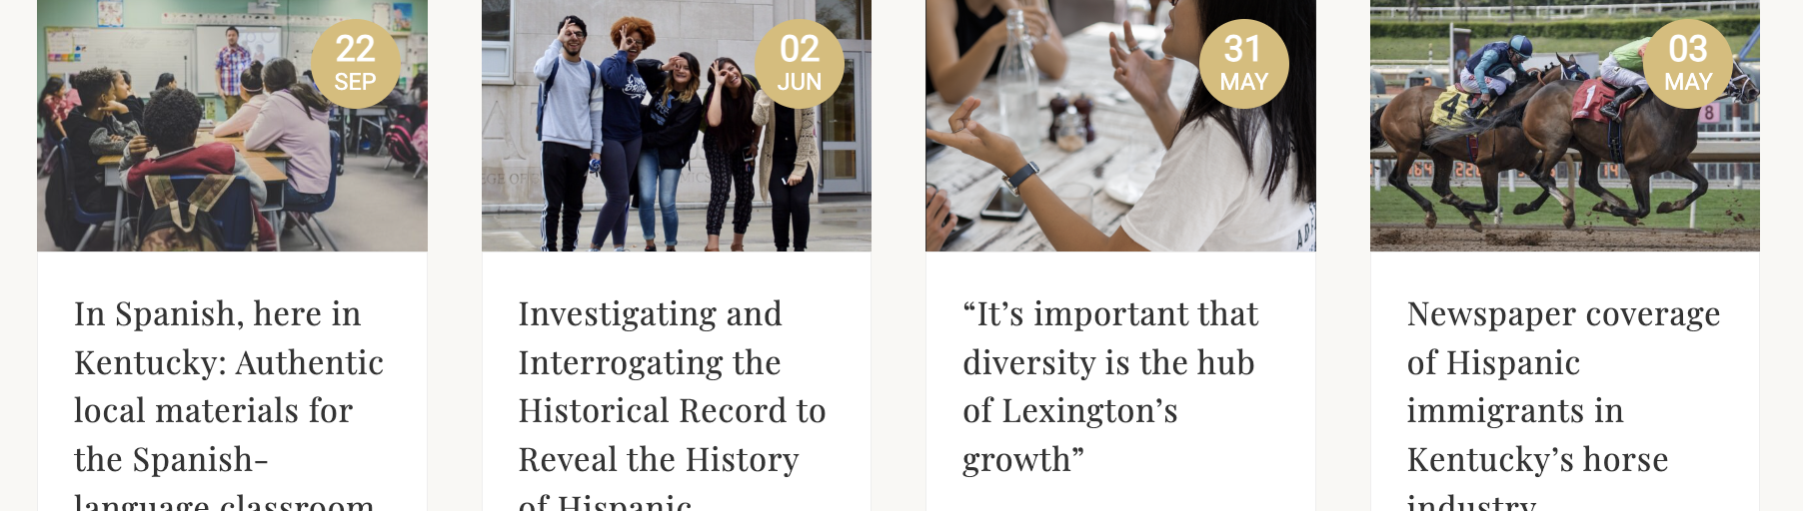
Home page

Slide 6
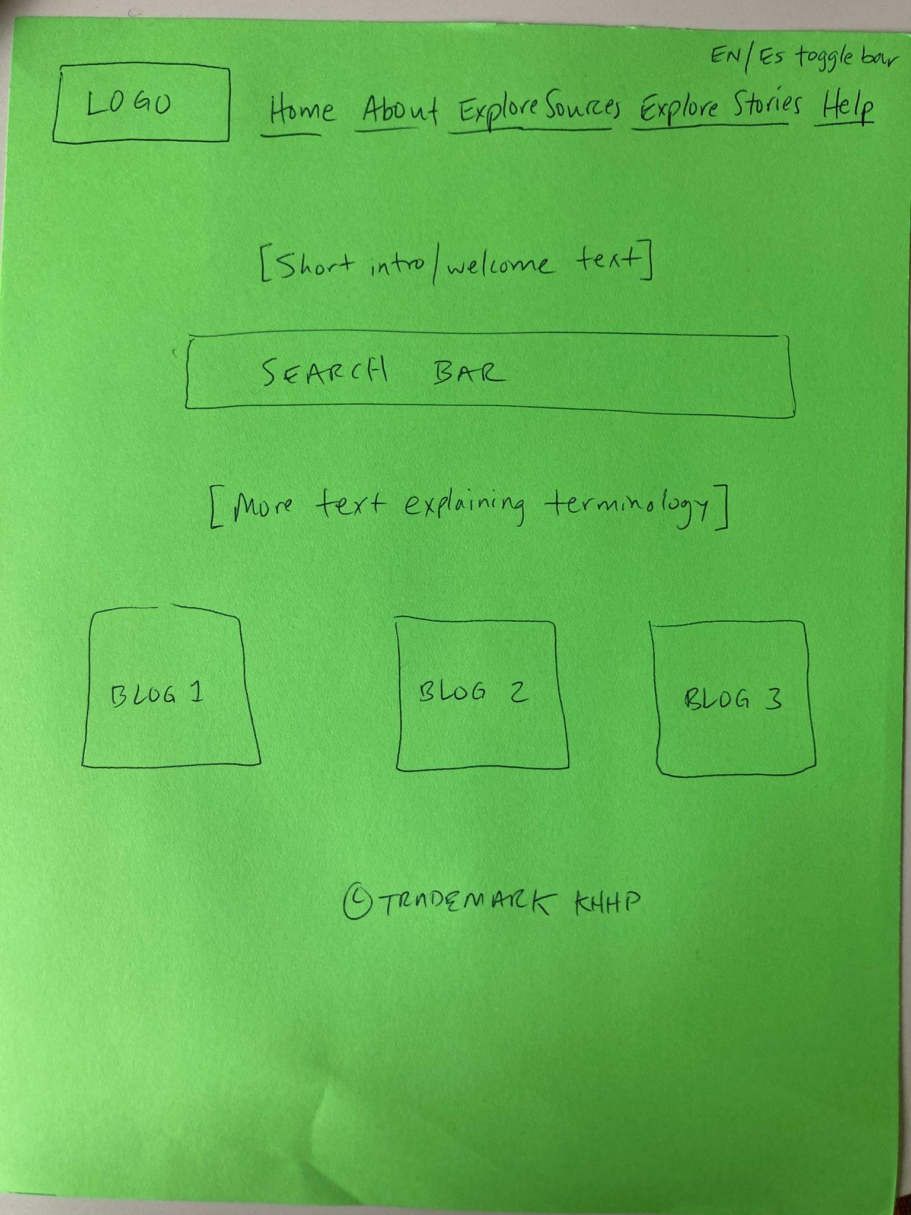
Layout of homepage

Slide 7
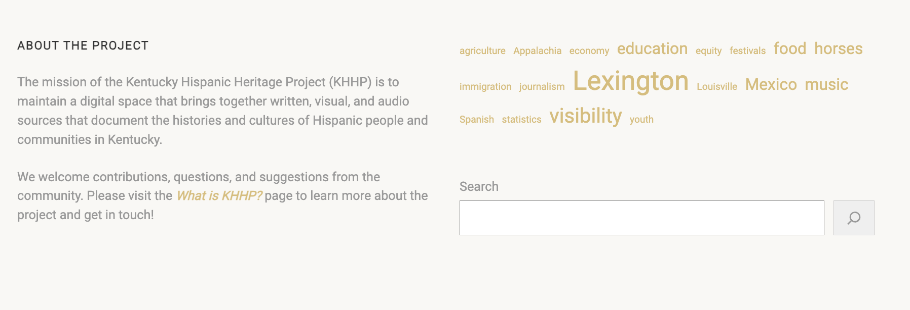
Home page footer - don’t need - remove

Slide 8

What is KHHP? → About
Information to include
What is the Kentucky….?
Contact us
Collaborating partners (UK A&S, Libraries, Unite)
Development Team
Contributors

Slide 9

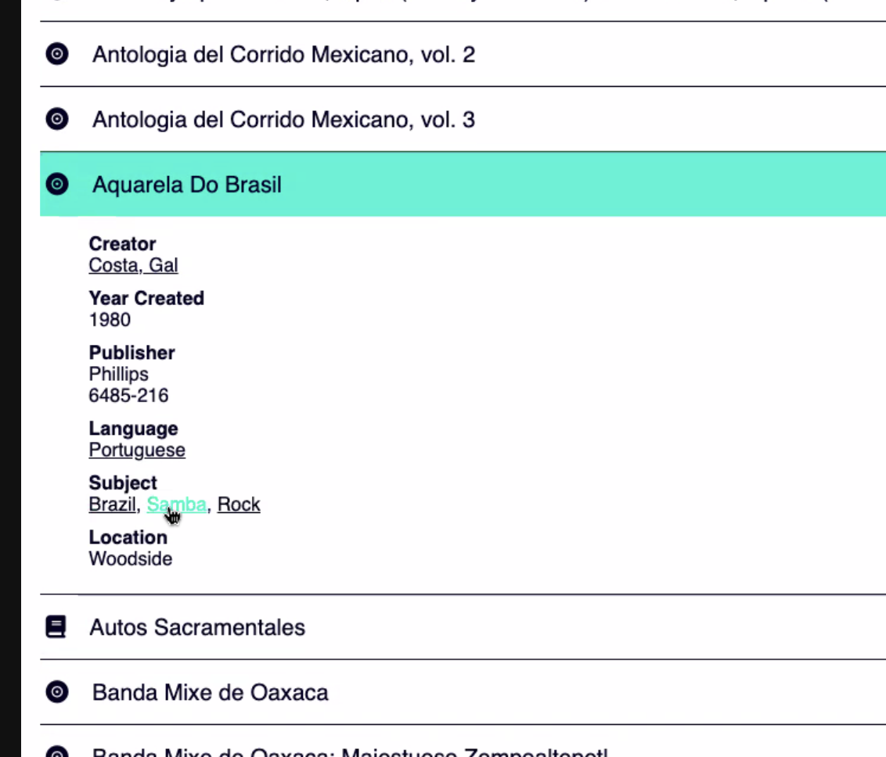
Explore sources
Dropdown with source types
Add advanced search
Icon for source type: Yes
Accordion: Yes
Before expanding accordion: Title, author, date
Expansion = full entry

Slide 10
Full entry: How to an individual source entry appears after searching (same information provided when expanding entry on library page without searching)
Static level (what you see upon searching)
icon that indicates source type
title
Author
Year
Drop down/opens upon clicking title
Full bibliographic citation
URL (links to UK source or online if available)
Subject(s)
Language (Spanish, English, Bilingual)

Slide 11
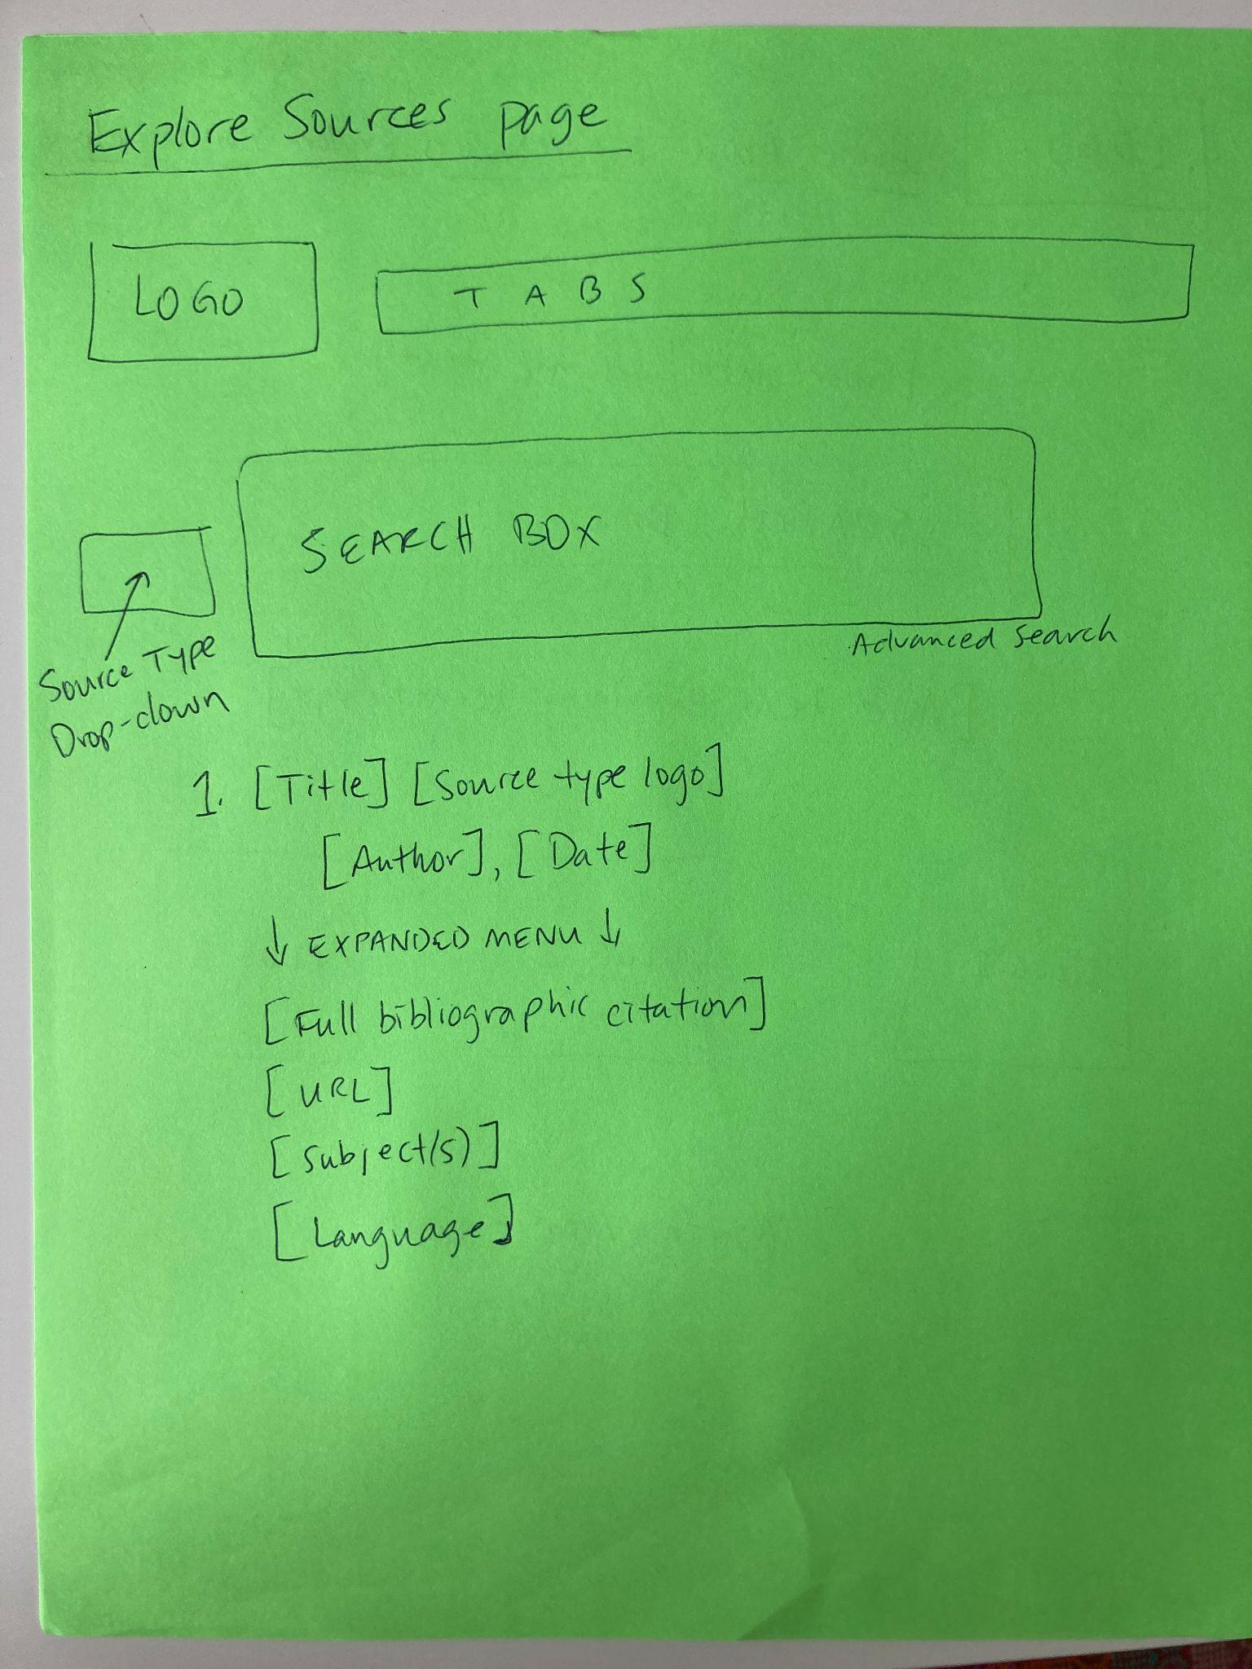
Explore Sources Page

Slide 12

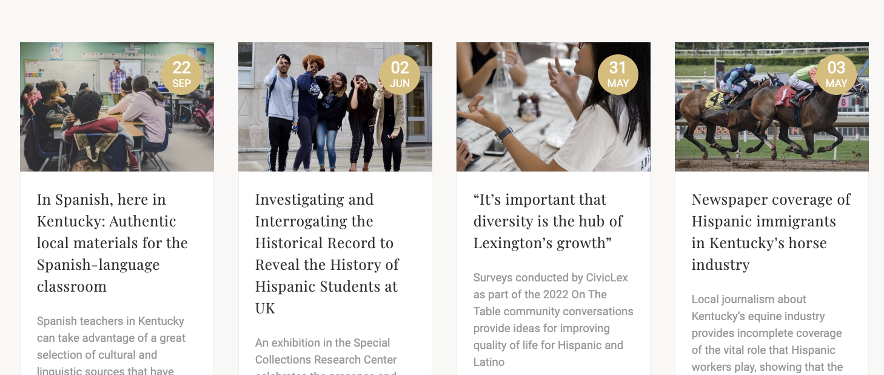
Explore by stories
Add a title

Slide 13
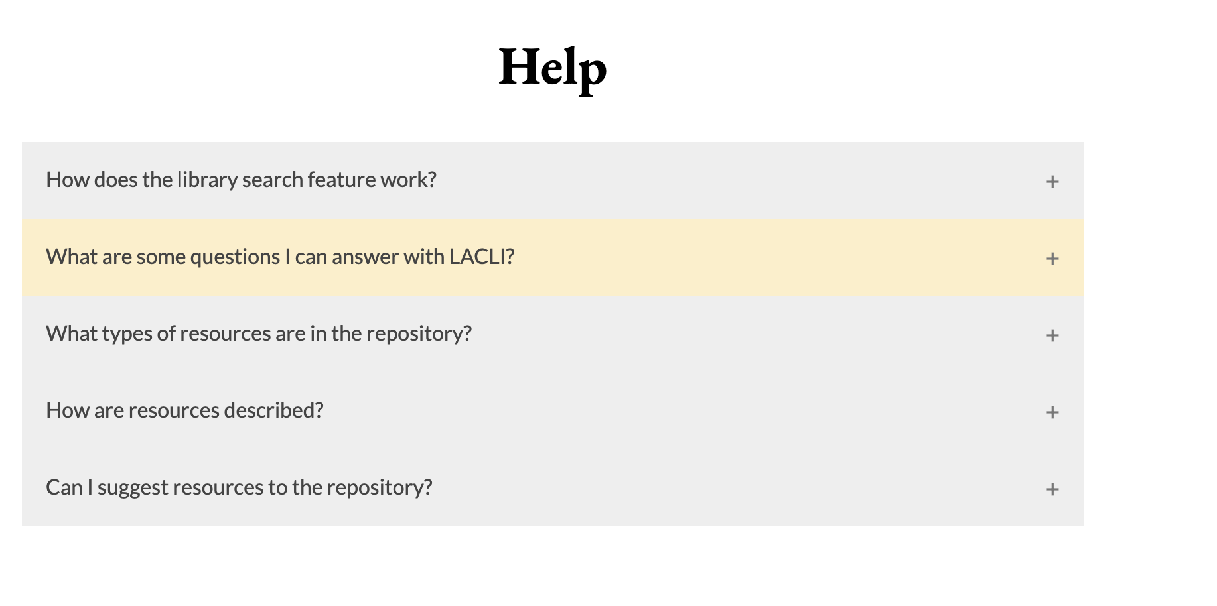
help

Slide 14



Logo Variations
White on Black
Colored
Black on White

Slide 15



Logo Variations
White on Black
Colored
Black on White

